Slide 1
BRITISH AIRLINES Sentiment Analysis

Slide 2
INTRODUCTION
This presentation contains the results of an analysis of customer reviews for British Airlines. The data was acquired from Skytrax as part of the virtual internship offered by Forage.

Slide 3
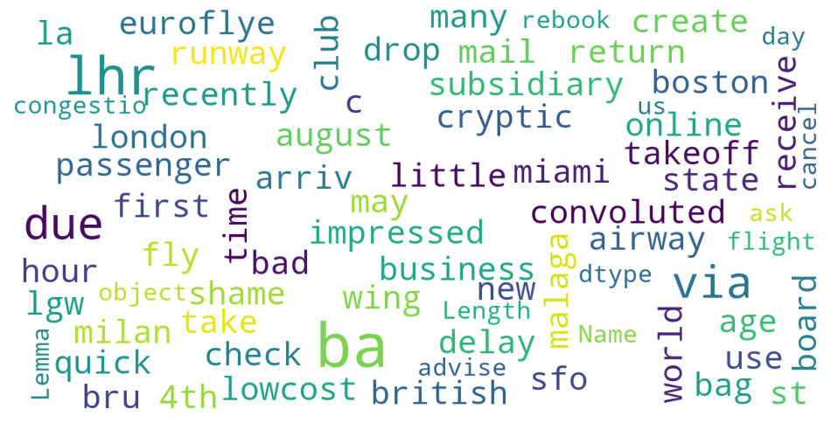
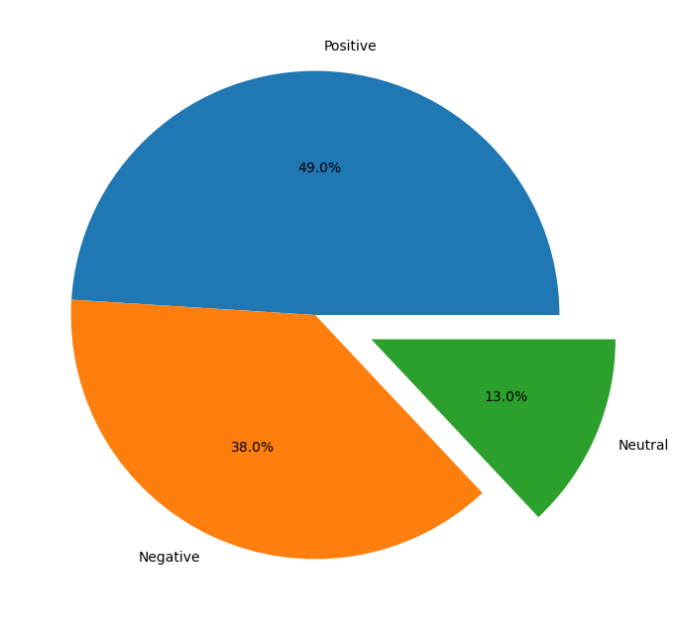
INSIGHTS GAINED
From 1500 customer reviews, we established the following:
Positive Reviews - 735
Negative Reviews - 570
Neutral Reviews - 195
Keywords from Reviews

Slide 4
THANK YOU!!

